Slide 1
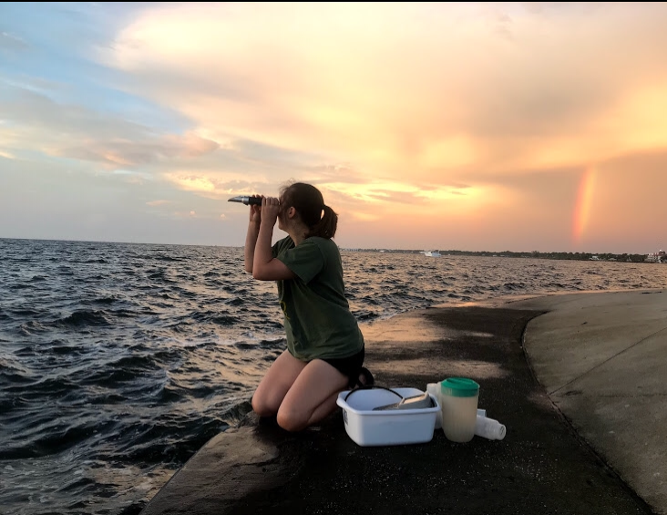
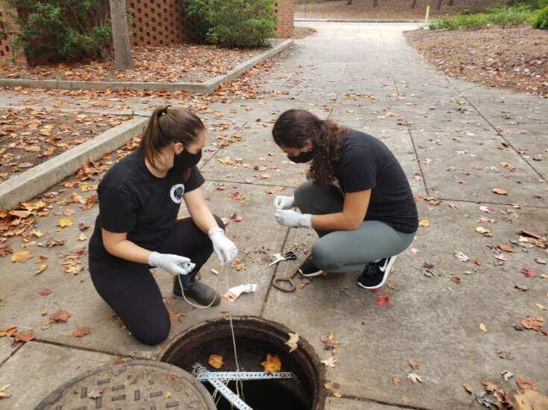
From Sea
Microbial Monitoring
in Natural and Built Environments
Megan Lott, PhD Student
Advised by Dr. Erin K. Lipp
To Sewer

Slide 2




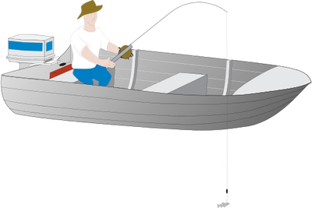
Live
Work
Play

Slide 3
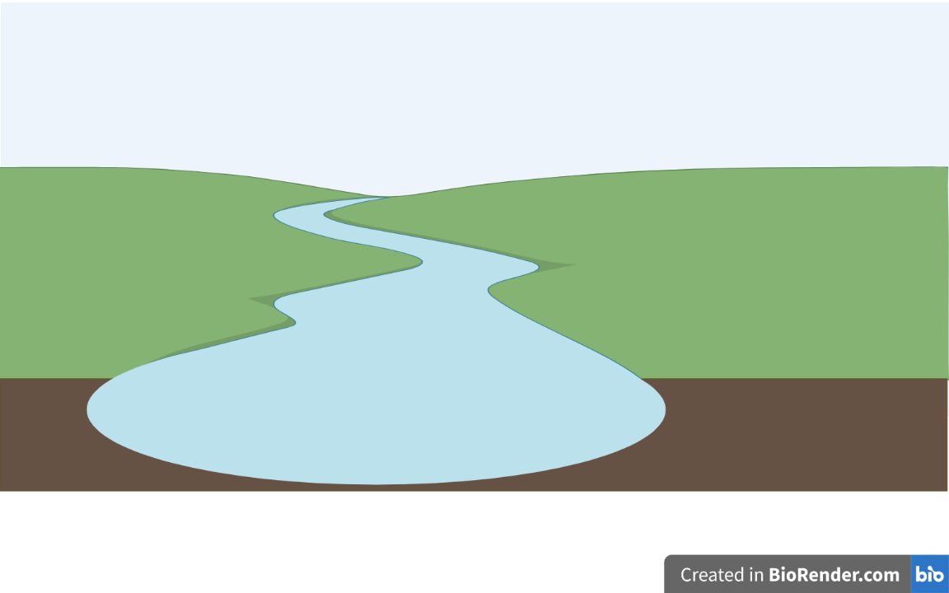


Slide 4
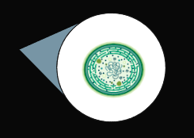

Slide 5

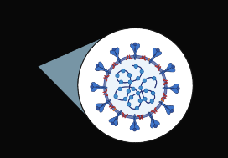

Slide 6
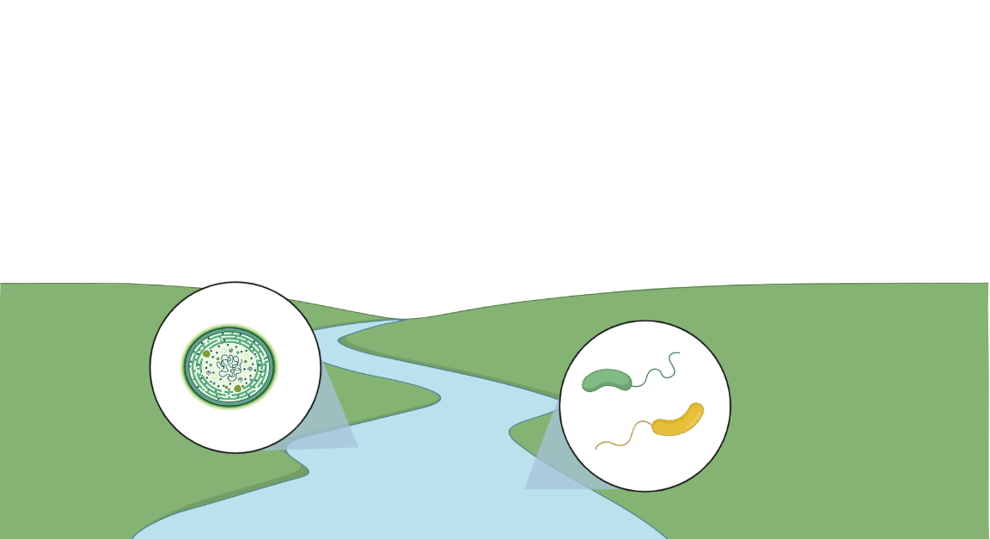
Chapter 1: Microbial Ecology of Vibrio bacteria in the Indian River Lagoon of Eastern Florida, USA
Chapter 2: Bacterial-Algal Community Dynamics in the Indian River Lagoon of Eastern Florida, USA

Slide 7

Chapter 3: Wastewater-based Surveillance for SARS-CoV-2 in Athens, Georgia, USA

Slide 8
Wastewater-based Surveillance for SARS-CoV-2 in Athens, Georgia
Megan Lott, William Norfolk, Cody Dailey,
Amelia Foley, Megan Robertson, Erin K. Lipp
Notes:
Thanks so much for the introduction, Dr. Tibull! And thanks so much for inviting me to join you all today. I am quite excited to connect with you all the way from Athens, Georgia! Today, I’ll be sharing a bit about our most recent research: monitoring wastewater for SARS-CoV-2

Slide 9
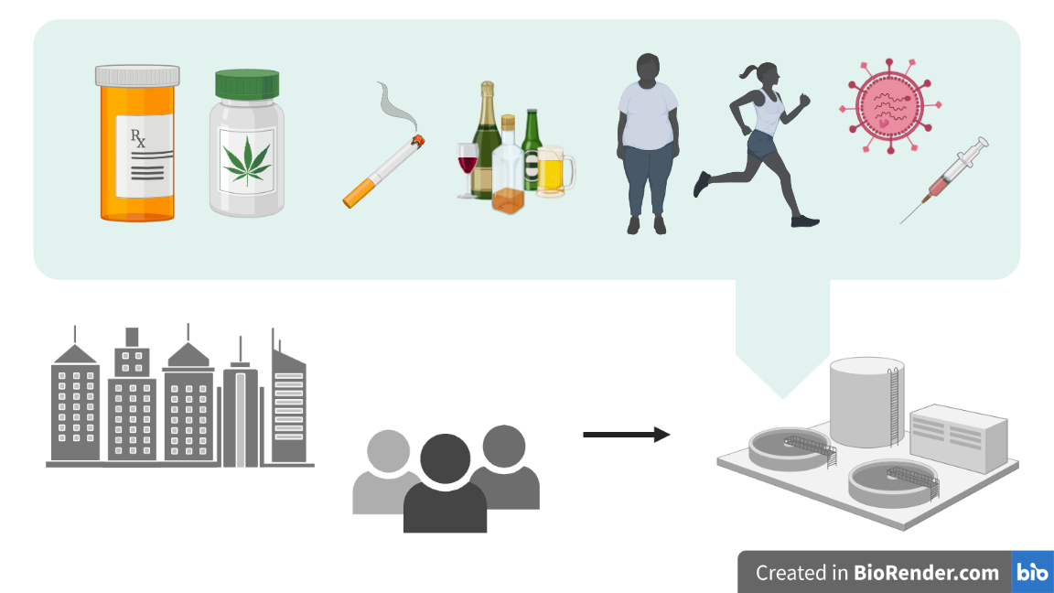
Notes:
While largely unseen, wastewater infrastructure can serve as a brilliant source of information about community health. Wastewater - collected across entire neighborhoods, towns, and cities - typically flows into a central receiving facility for wastewater reclamation. By monitoring wastewater for health indicators (i.e. metabolites, prescription and illicit drugs, or pathogens), we can capture a snapshot of our community’s health. We are provided with health data in a single sample, without the need for extensive clinical testing. In this way, our wastewater infrastructure serves as an “information highway.”

Slide 10
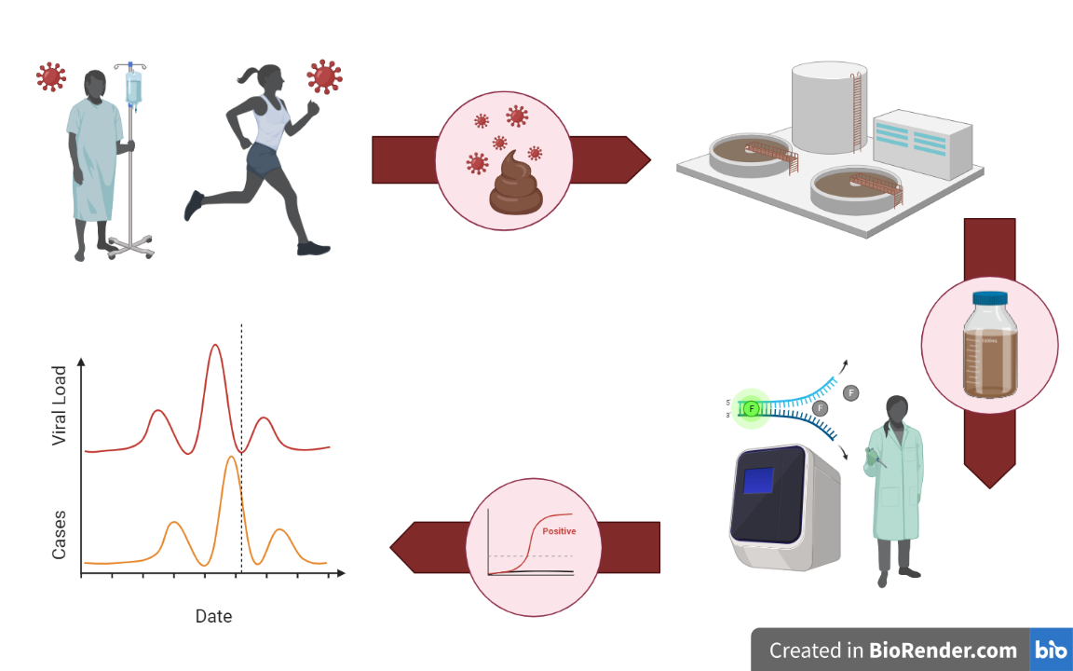
Wastewater-based Surveillance
for SARS-CoV-2
Notes:
In response to the COVID-19 pandemic, we have been exploring the use of wastewater-based monitoring to estimate trends in community-scale circulation of disease. In this approach, we collect and analyze wastewater samples for SARS-CoV-2, the virus responsible for the COVID-19 disease.

Slide 11
Wastewater-based Surveillance
for SARS-CoV-2
Notes:
In response to the COVID-19 pandemic, we have been exploring the use of wastewater-based monitoring to estimate trends in community-scale circulation of disease. In this approach, we collect and analyze wastewater samples for SARS-CoV-2, the virus responsible for the COVID-19 disease.

Slide 12
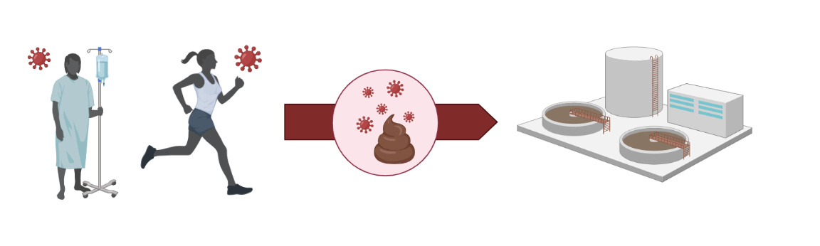
Background

Slide 15
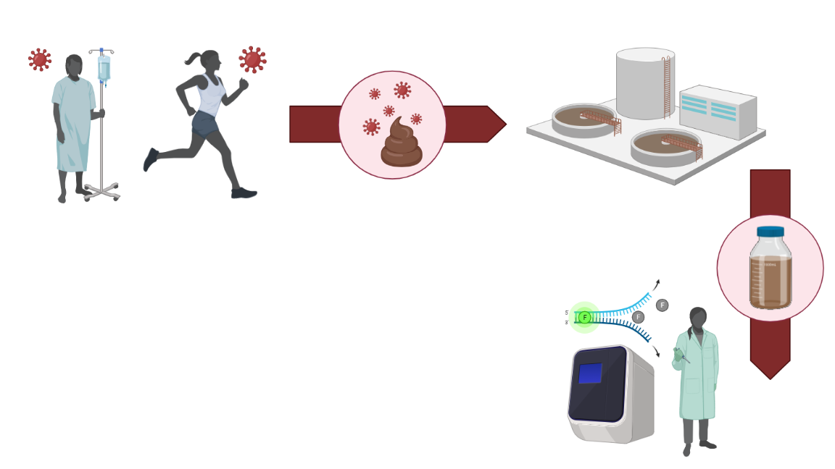
Methods

Slide 16
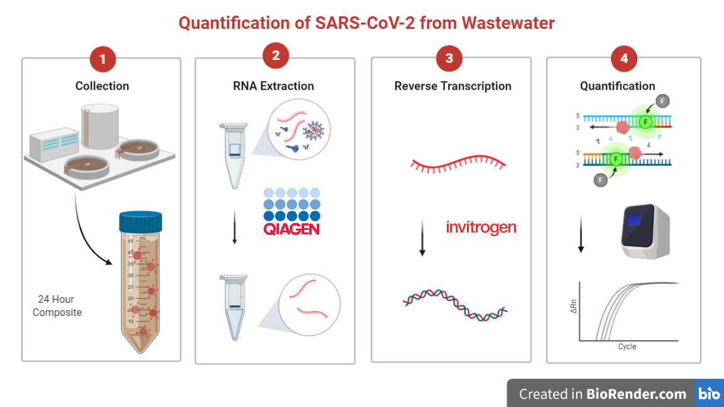

Slide 18
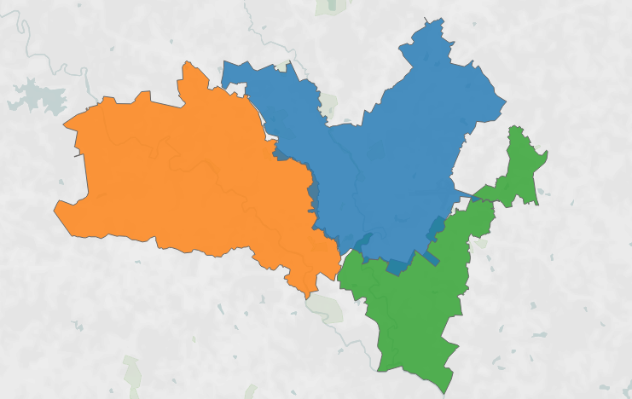
Notes:
Needs to be changed!!! Add in sewer map + emojis of the different contributions to each catchment area
+ highly residential + hospital +
Tell the story of this slide
Here is Athens.
We started by sampling three water treatment facilities in Athens.
Within each catchment area, there are different contributions that lead to different wastewater – catching different scopes of our community
Wasteater information highway

Slide 19

Catchment A
5.32 MGD
Notes:
Needs to be changed!!! Add in sewer map + emojis of the different contributions to each catchment area
+ highly residential + hospital +
Tell the story of this slide
Here is Athens.
We started by sampling three water treatment facilities in Athens.
Within each catchment area, there are different contributions that lead to different wastewater – catching different scopes of our community
Wasteater information highway

Slide 20
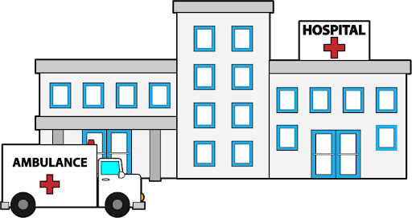
Catchment A
5.32 MGD
Catchment B
4.80 MGD
Notes:
Needs to be changed!!! Add in sewer map + emojis of the different contributions to each catchment area
+ highly residential + hospital +
Tell the story of this slide
Here is Athens.
We started by sampling three water treatment facilities in Athens.
Within each catchment area, there are different contributions that lead to different wastewater – catching different scopes of our community
Wasteater information highway

Slide 21

Catchment A
5.32 MGD
Catchment B
4.80 MGD
Catchment C
1.99 MGD
Notes:
Needs to be changed!!! Add in sewer map + emojis of the different contributions to each catchment area
+ highly residential + hospital +
Tell the story of this slide
Here is Athens.
We started by sampling three water treatment facilities in Athens.
Within each catchment area, there are different contributions that lead to different wastewater – catching different scopes of our community
Wasteater information highway

Slide 23
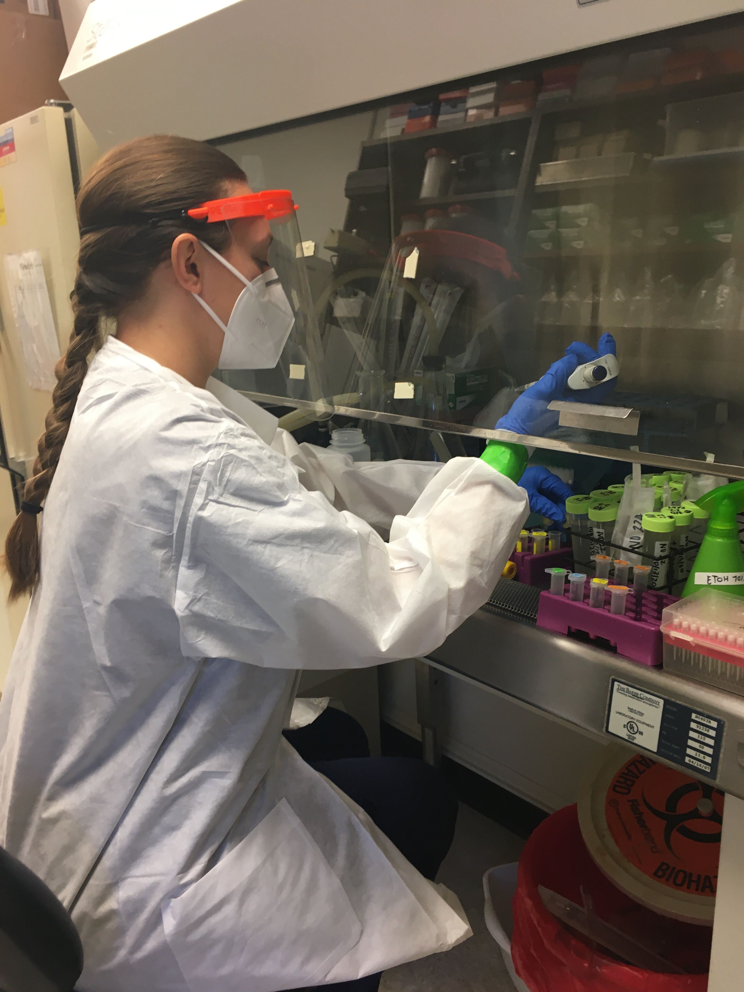
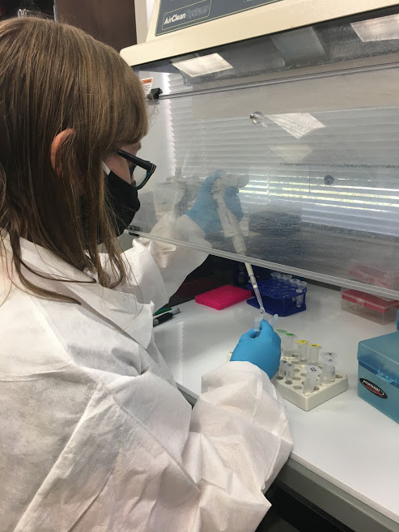
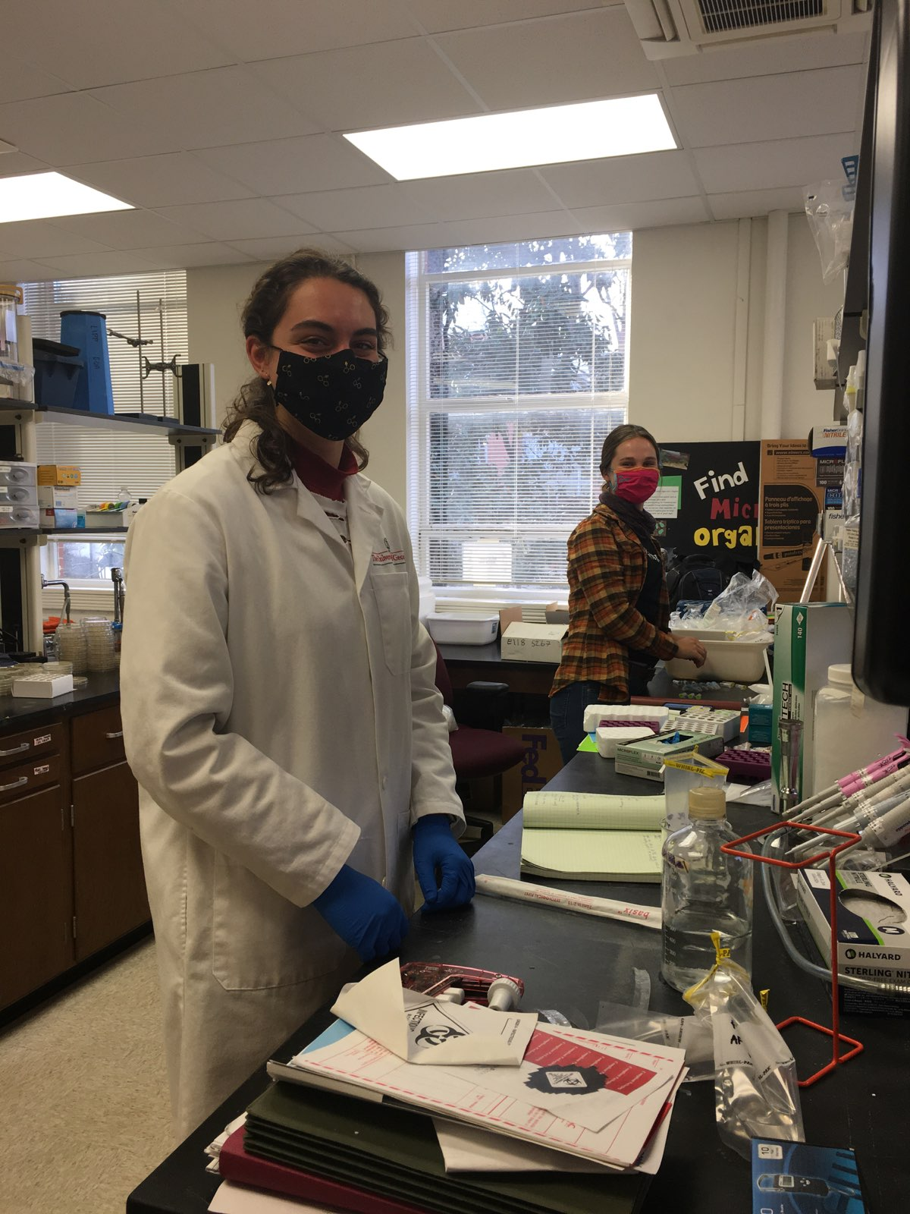

Slide 25
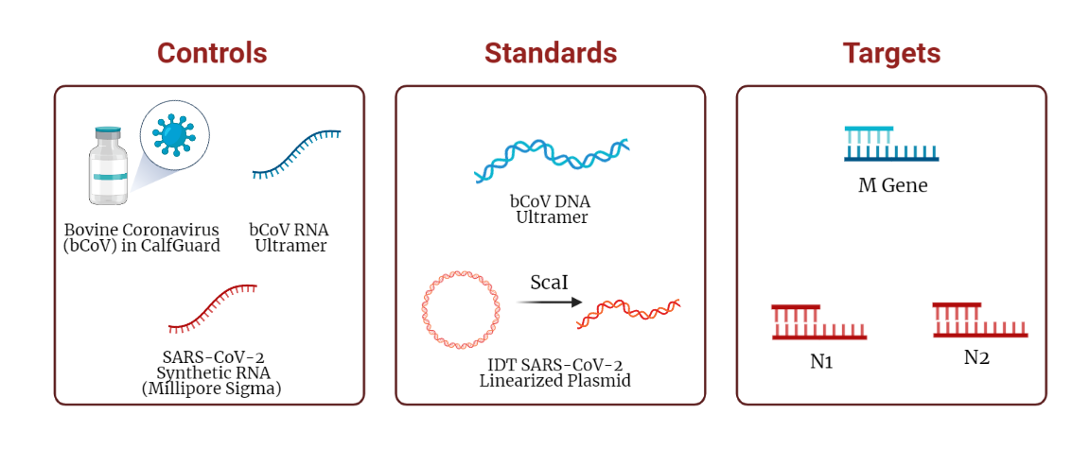

Slide 26
Results

Slide 27

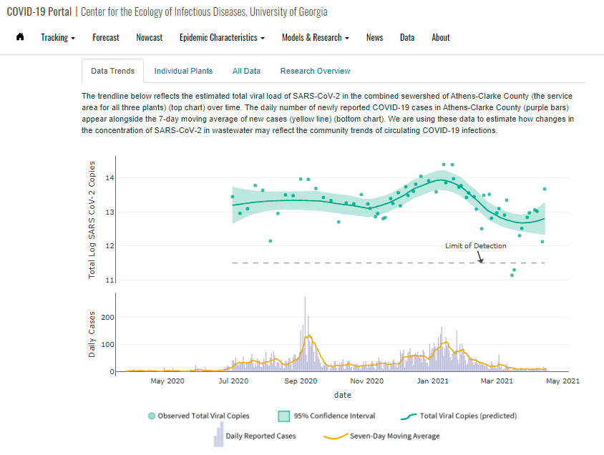

covid19.uga.edu/wastewater-athens

Slide 28
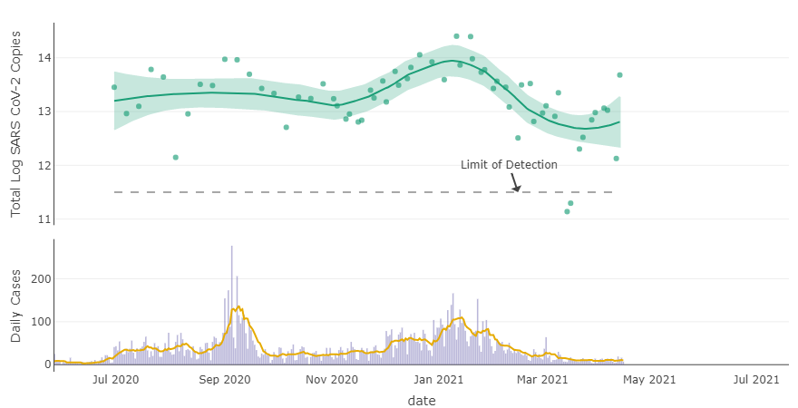
Total Viral Load of SARS-CoV-2 Viral RNA in Wastewater from Athens-Clarke County
N1-N2 Avg
LOESS Trend

Slide 29
Total Viral Load of SARS-CoV-2 Viral RNA in Wastewater from Athens-Clarke County
N1-N2 Avg
LOESS Trend
Daily Cases
7-Day Avg

Slide 30
Total Viral Load of SARS-CoV-2 Viral RNA in Wastewater from Athens-Clarke County
N1-N2 Avg
LOESS Trend
Daily Cases
7-Day Avg

Slide 31
Total Viral Load of SARS-CoV-2 Viral RNA in Wastewater from Athens-Clarke County
N1-N2 Avg
LOESS Trend
Daily Cases
7-Day Avg

Slide 32
Total Viral Load of SARS-CoV-2 Viral RNA in Wastewater from Athens-Clarke County
N1-N2 Avg
LOESS Trend
Daily Cases
7-Day Avg

Slide 33
Total Viral Load of SARS-CoV-2 Viral RNA in Wastewater from Athens-Clarke County
N1-N2 Avg
LOESS Trend
Daily Cases
7-Day Avg

Slide 34
Total Viral Load of SARS-CoV-2 Viral RNA in Wastewater from Athens-Clarke County
N1-N2 Avg
LOESS Trend
Daily Cases
7-Day Avg

Slide 35
Total Viral Load of SARS-CoV-2 Viral RNA in Wastewater from Athens-Clarke County
N1-N2 Avg
LOESS Trend
Daily Cases
7-Day Avg

Slide 36
How well does the total viral load in wastewater correlate with the number of reported cases?

Slide 37

How well does the total viral load in wastewater correlate with the number of reported cases?

Slide 38
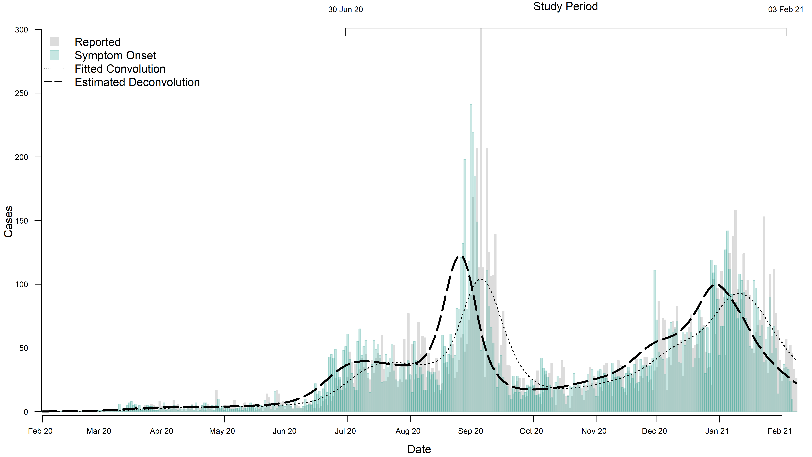

Slide 39
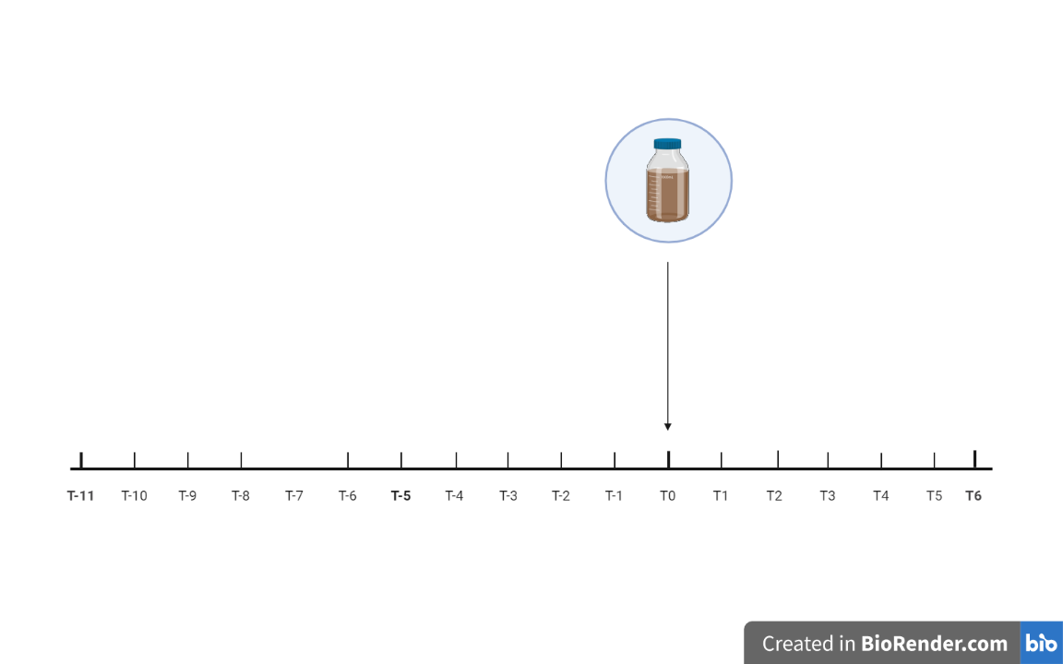
How well does the total viral load in wastewater correlate with the number of reported cases?

Slide 40
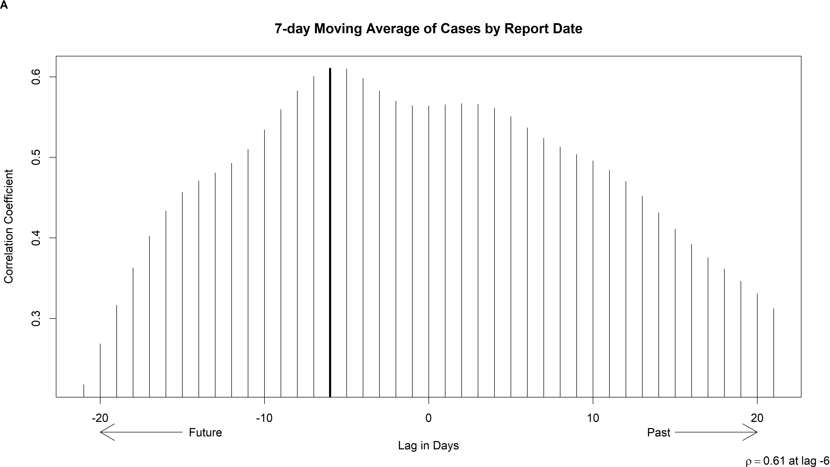
The total viral load is correlated with the number of cases reported 6 days in the future.
There is a lead time of 6 days.

Slide 41
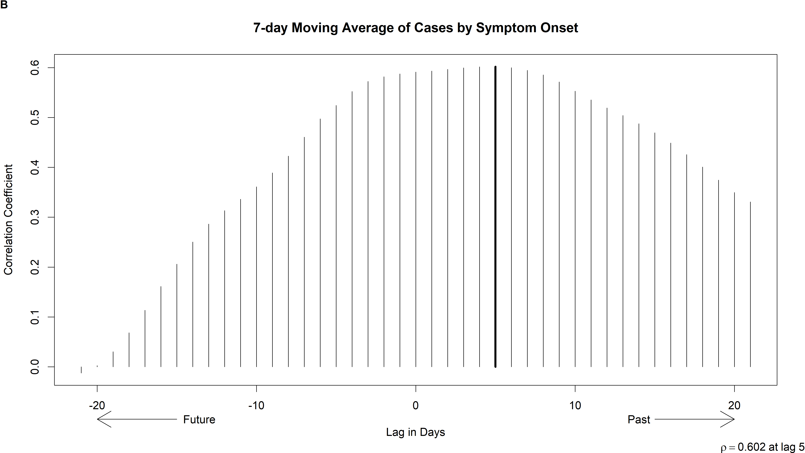
The total viral load lags behind the number of cases by symptom onset. This lag is ~ 5 days.

Slide 42
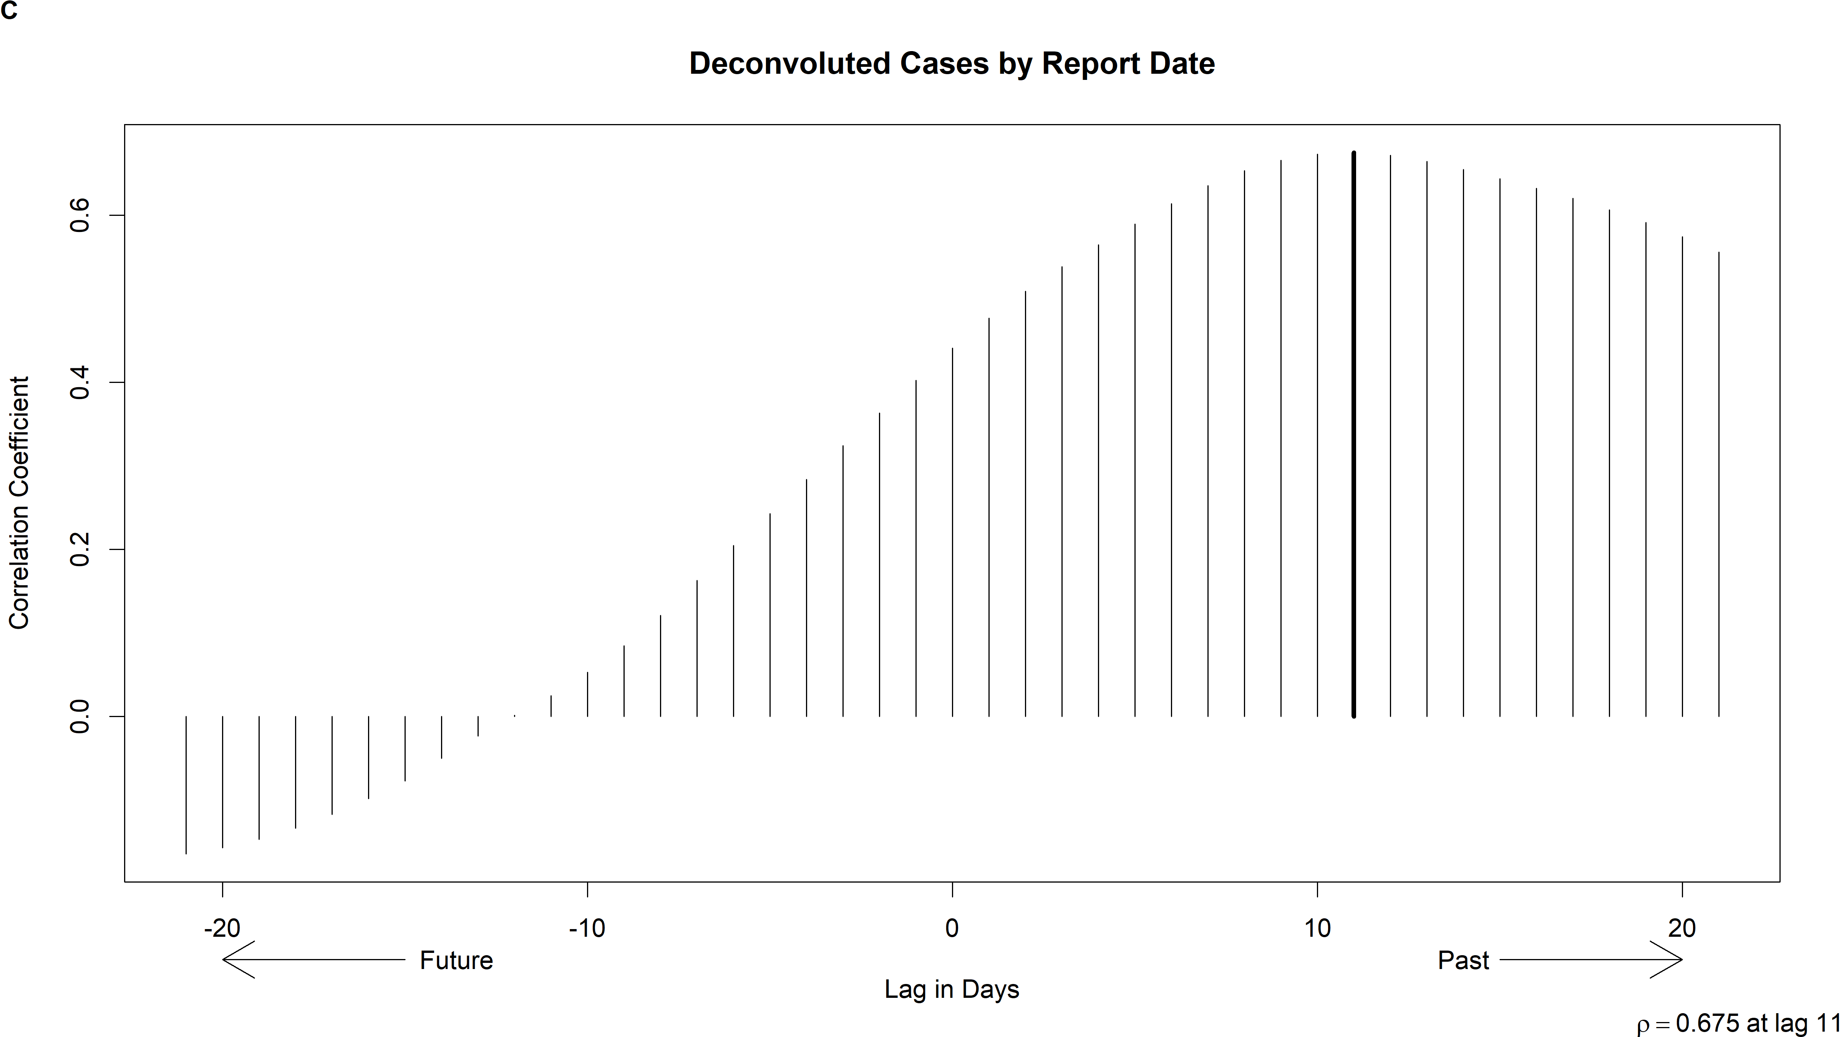
The total viral load lags behind the case incidence. This lag is ~ 11 days.

Slide 44
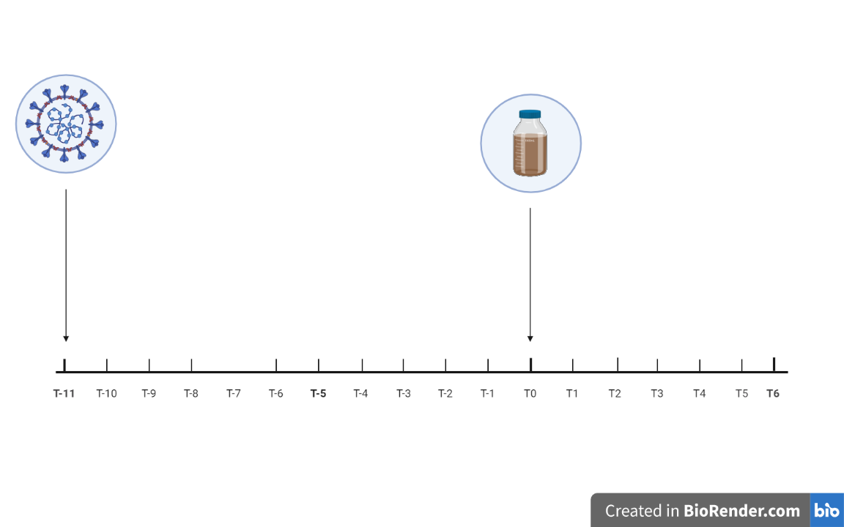

Slide 45
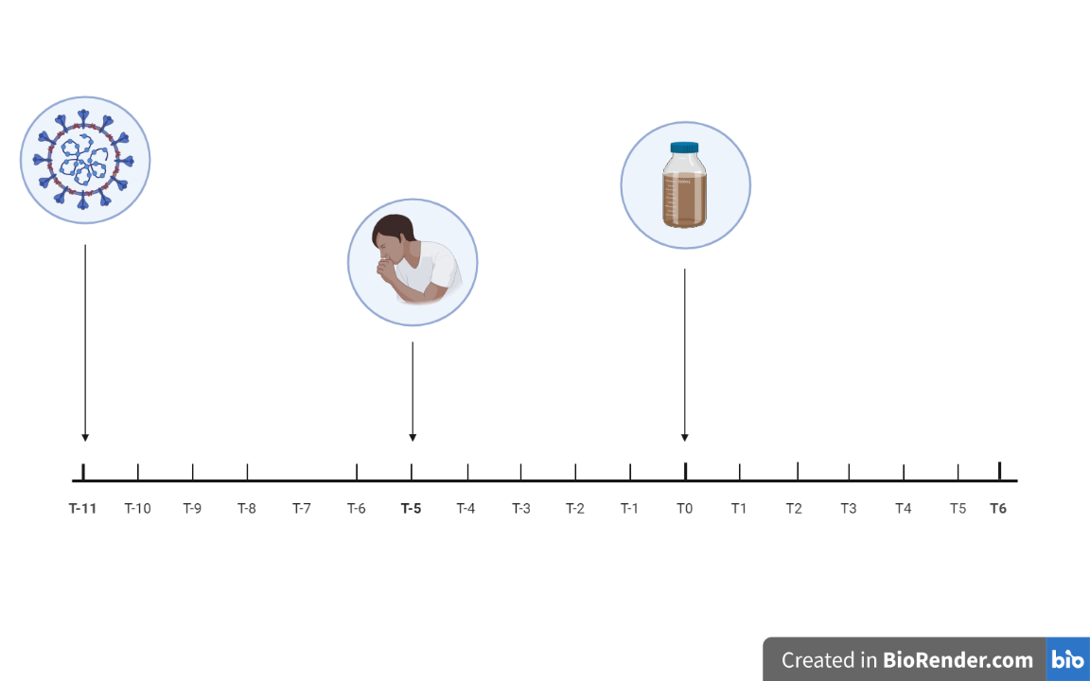

Slide 46
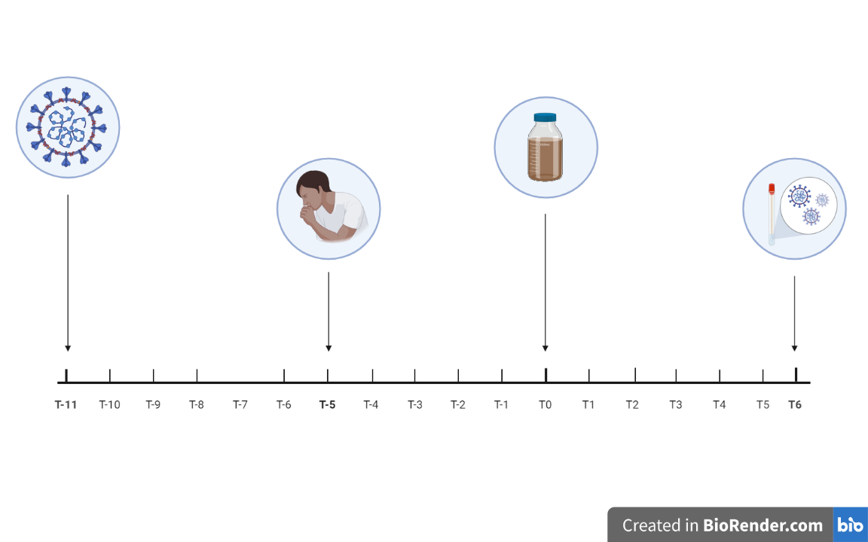

Slide 47
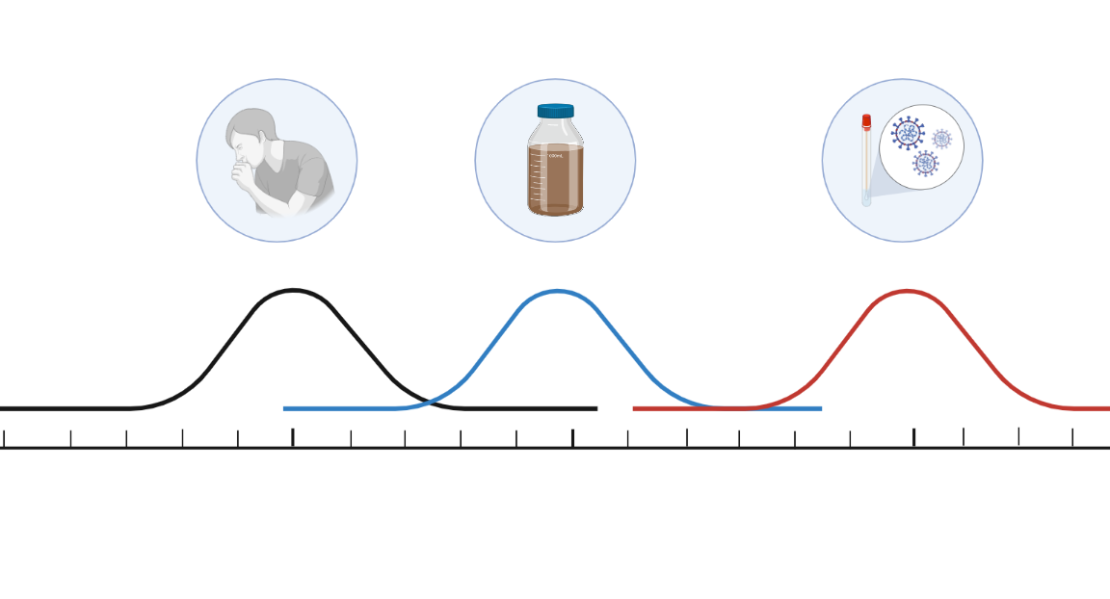

Slide 48

Predictive Modeling from
Total Viral Load in Wastewater

Slide 49
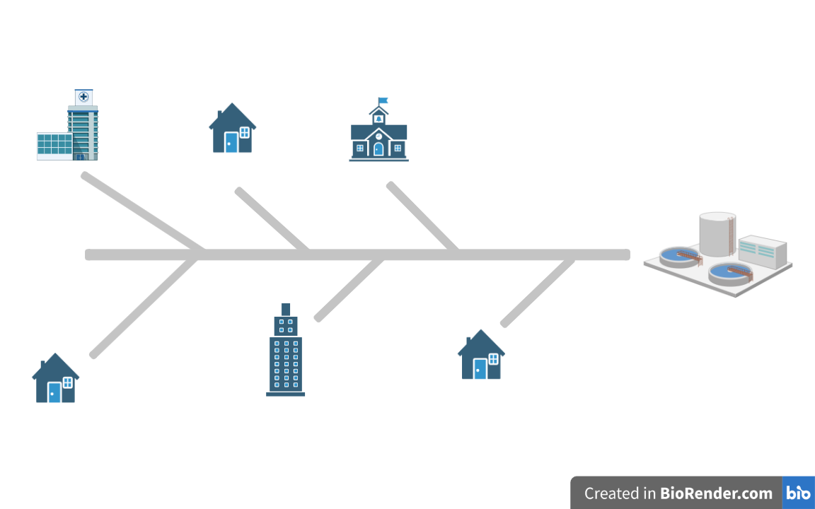
Sewer Line Surveillance

Slide 50
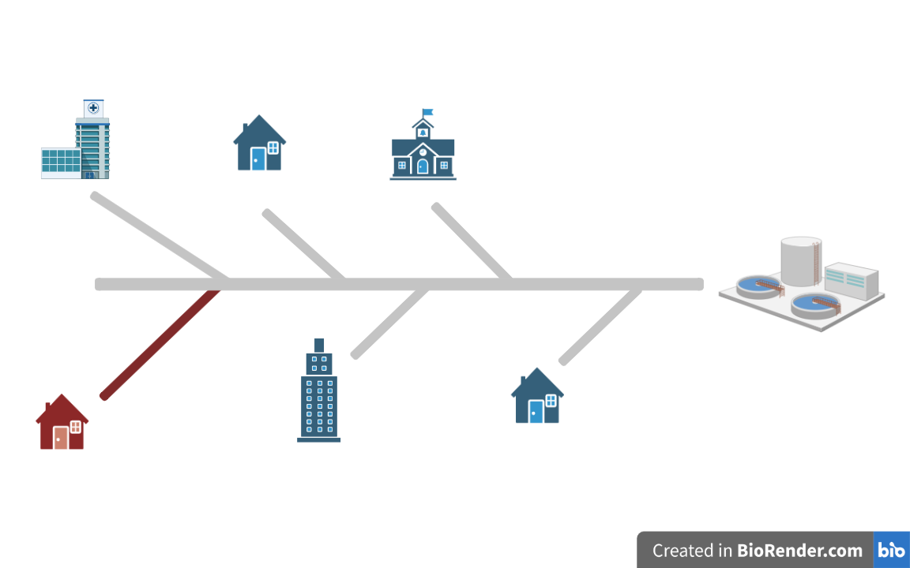
Sewer Line Surveillance

Slide 51
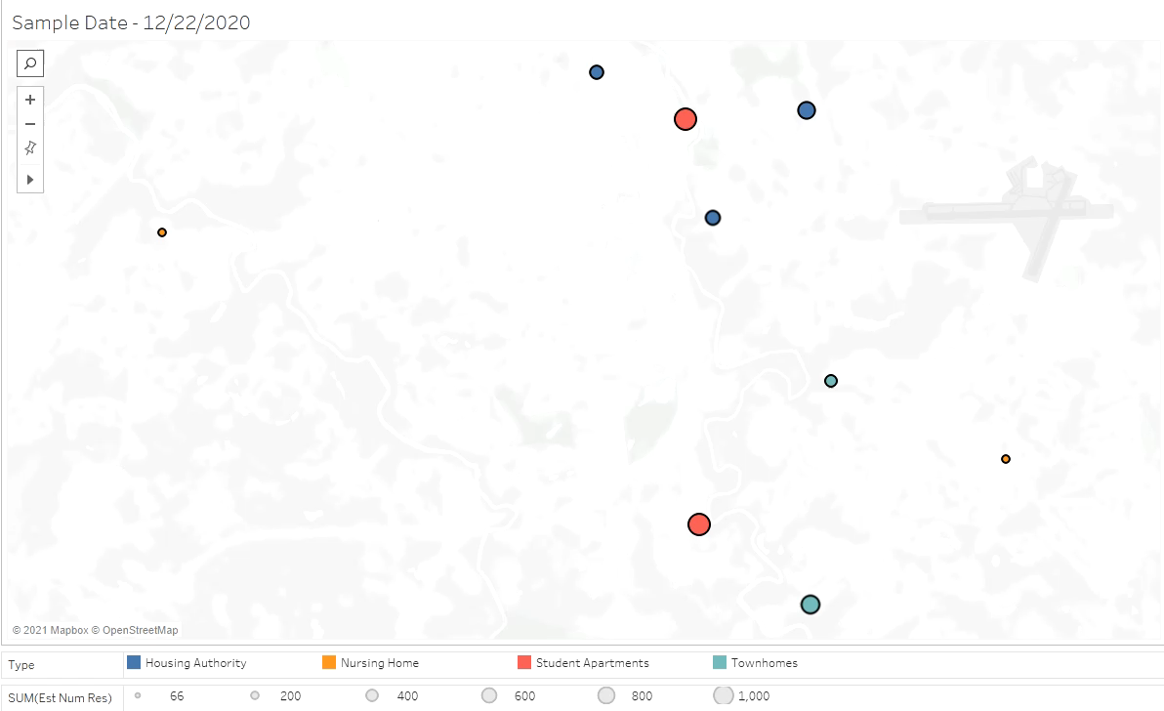

Slide 52


